Slide 1
SPLIT-BELT PAPER
Add and arrange figures (2024 June)

Slide 2
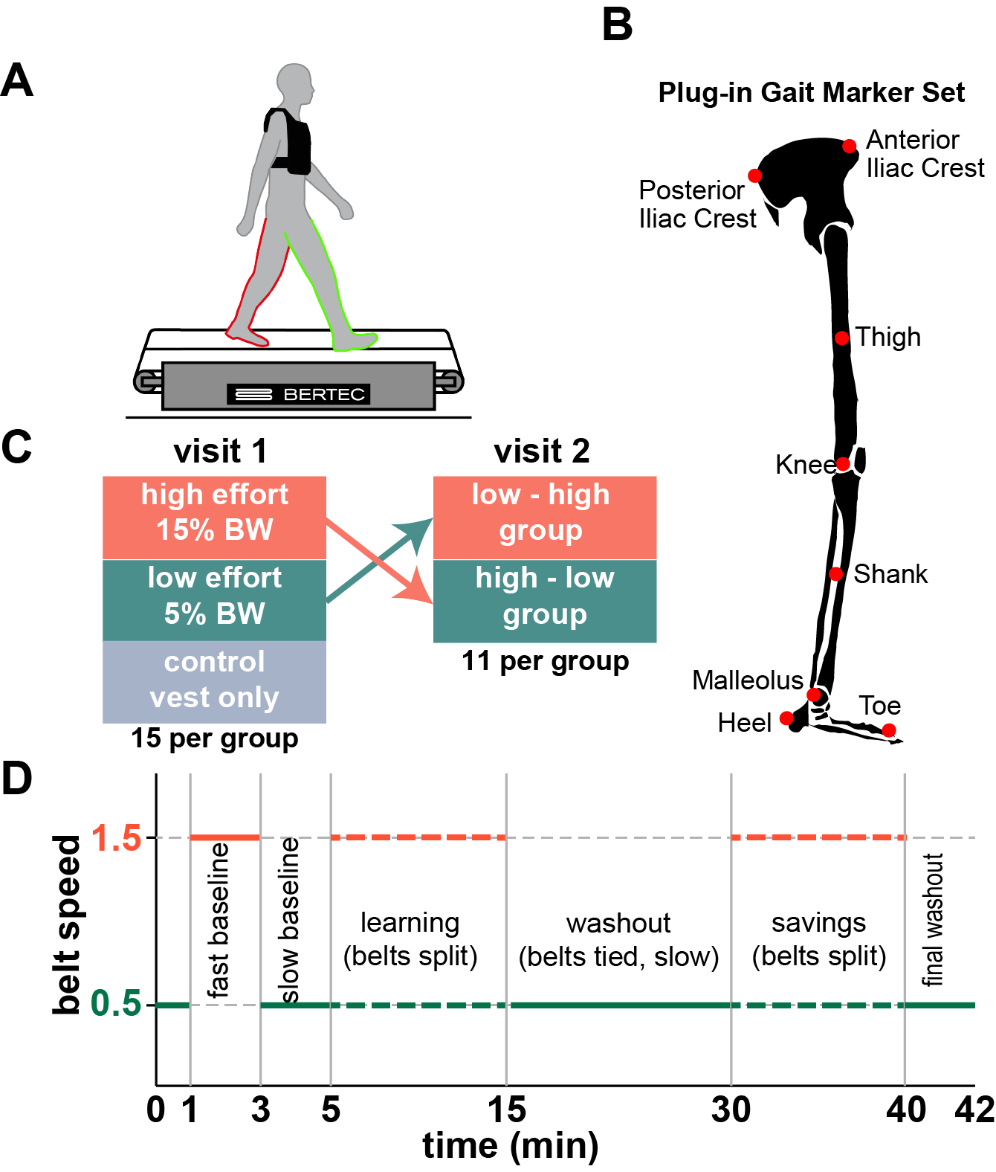

Slide 4
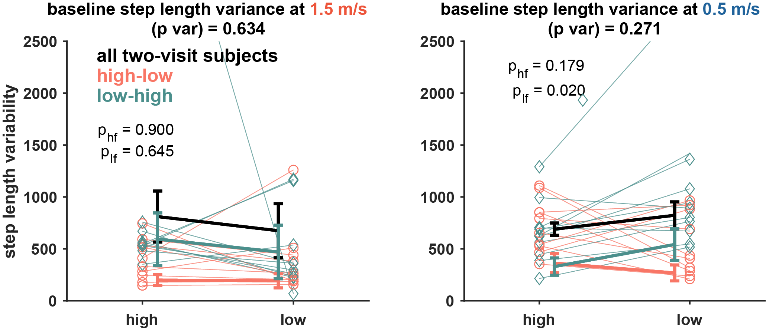

Slide 5
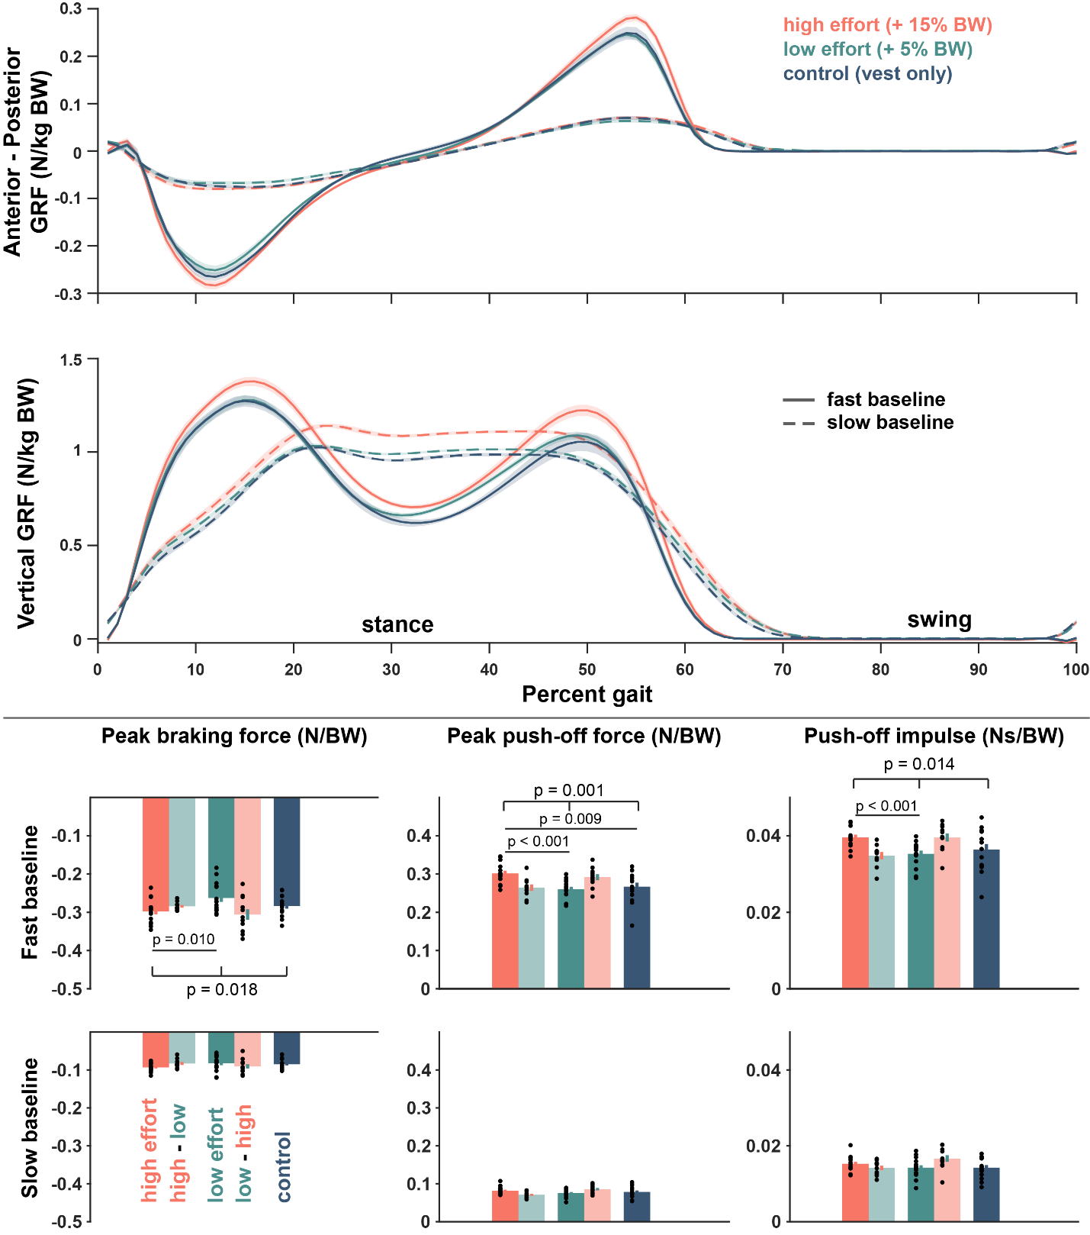
Ground reaction force profiles

Slide 6
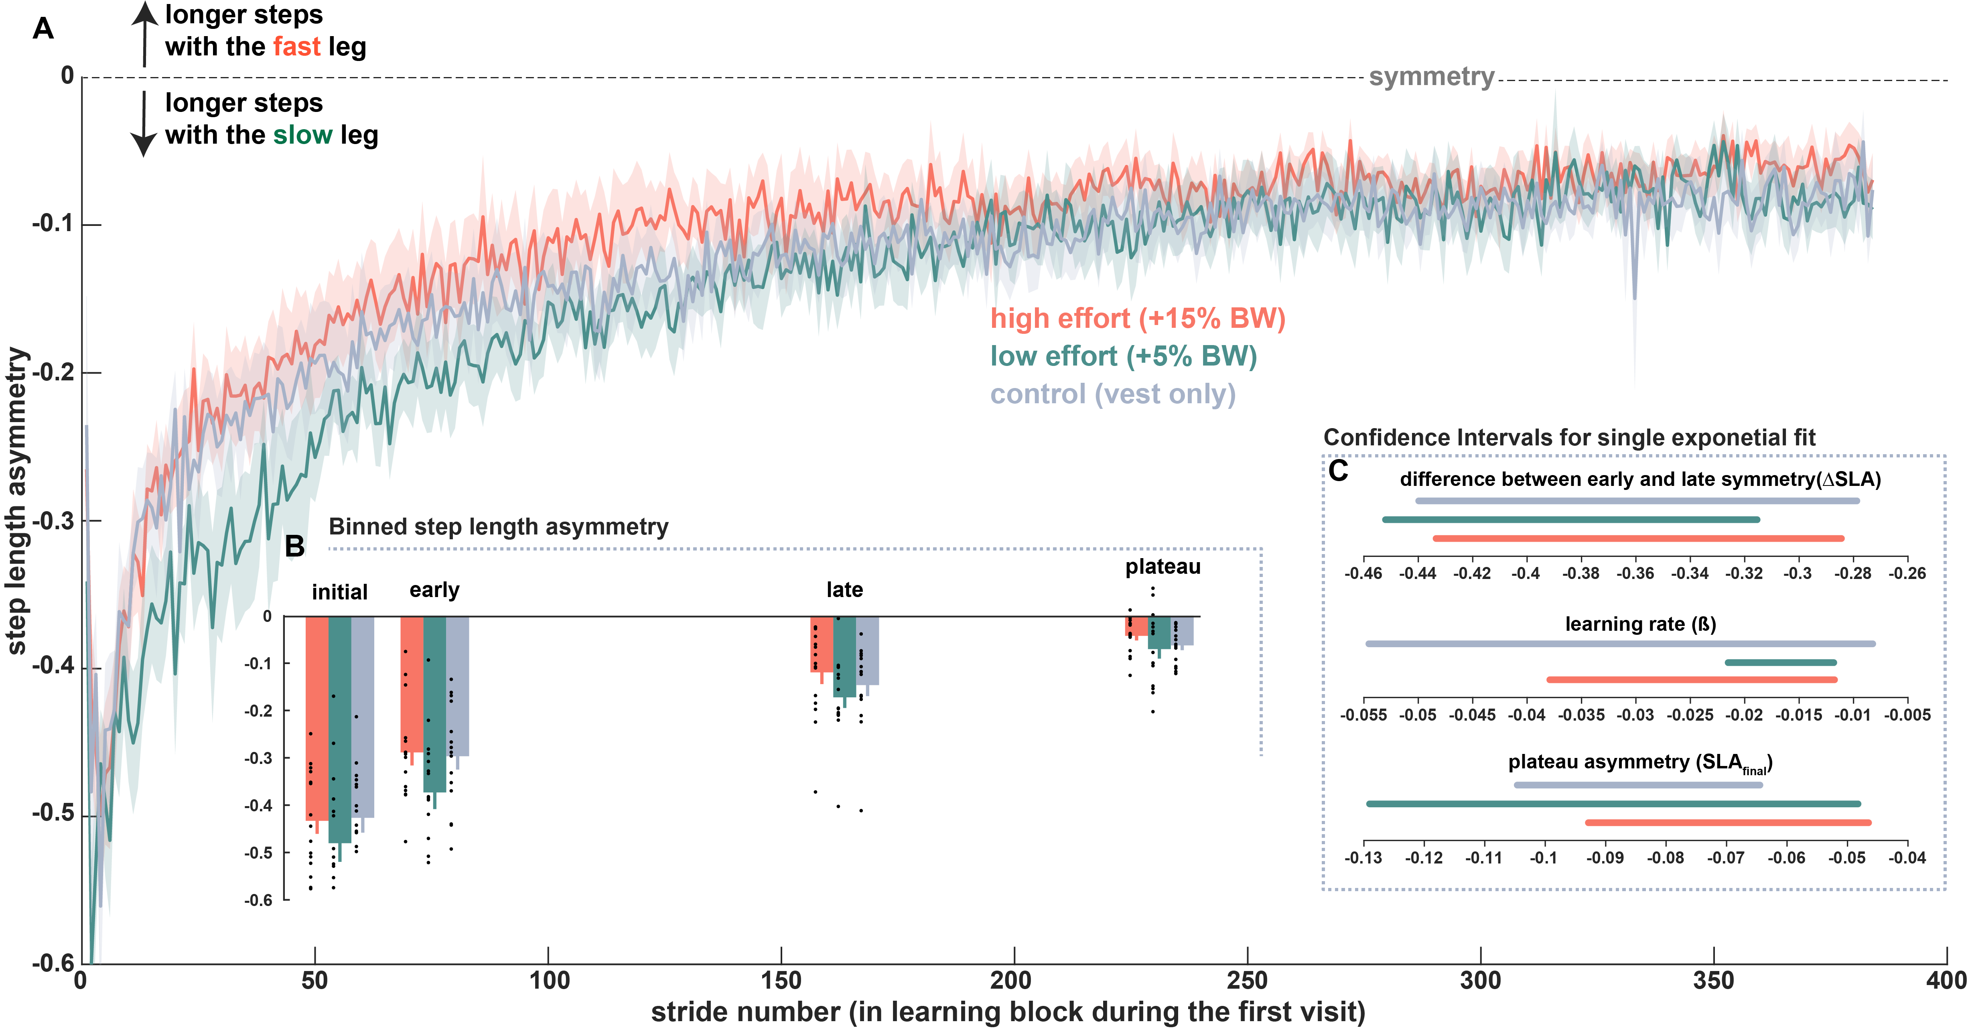

Slide 7
Step length variance

Slide 8
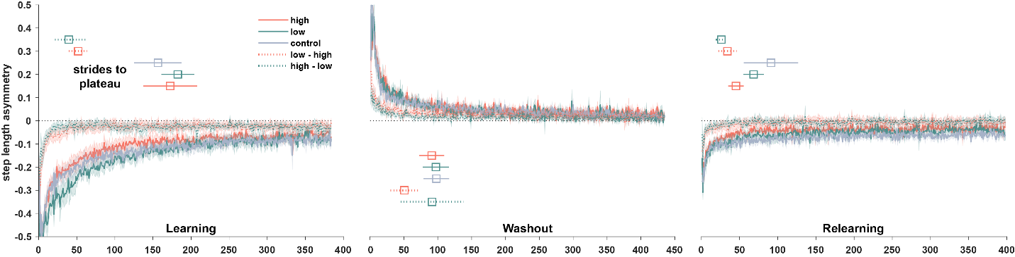

Slide 9
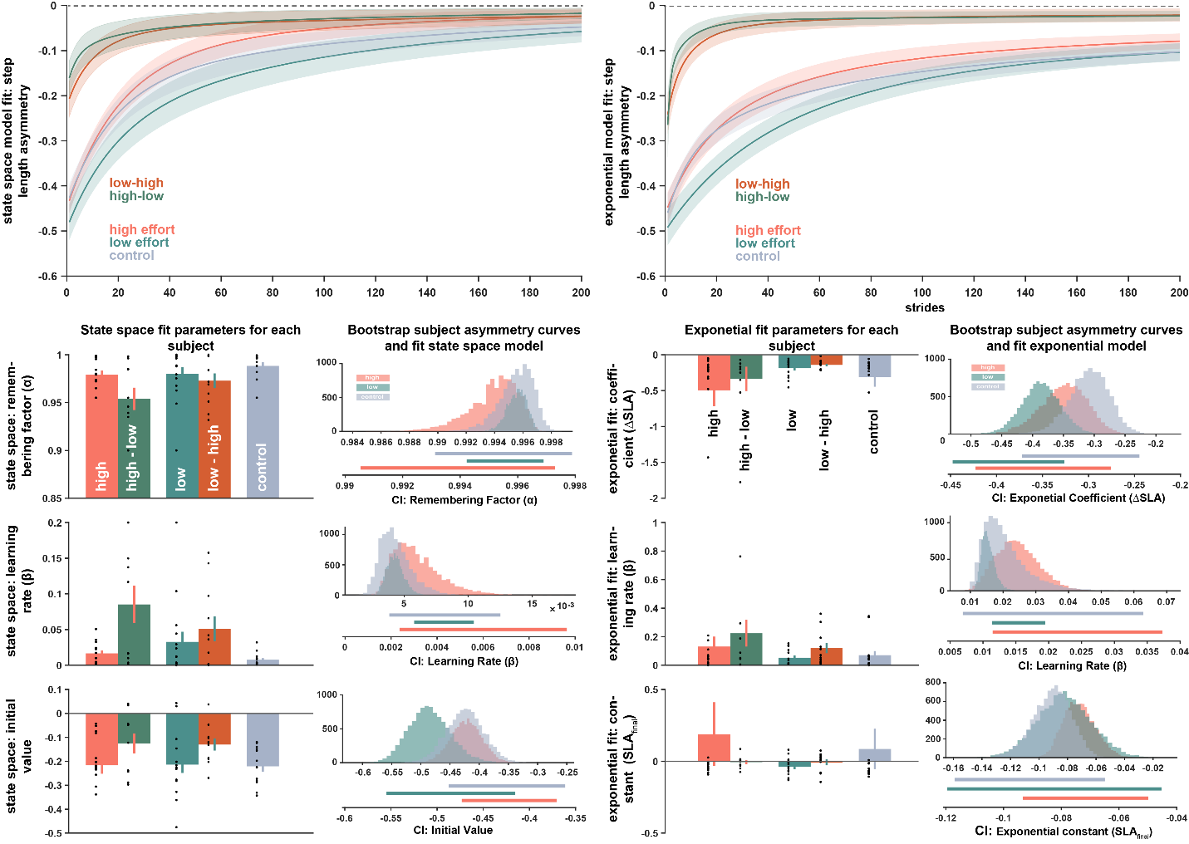

Slide 11
Washout

Slide 12
relearning

Slide 13
